Slide 1
RFID and LOAD CELL DEVICES
With RS-232 Interface using USB 2.0
MBRose Aps 20141204
Henrik Johansen, Søren Ellegaard

Slide 2
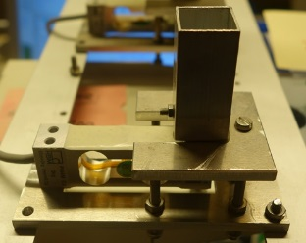
2 Kg load cell, (0.05 g)
Over load protection

Slide 3
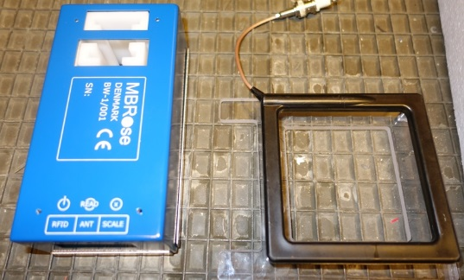
Load Cell and RFID Reader in one unit
Mechanical load cell assembly
RFID Antenna 90x90 mm
Device with load cell and RFID reader
BW-1
Connection here…
Balance output: RS-232
RFID output: RS-232
RFID Antenna Input

Slide 4
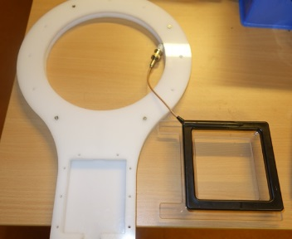
RFID Antenna – 2 sizes
RFID Antenna Diameter 185 mm
RFID Antenna 90x90 mm

Slide 5
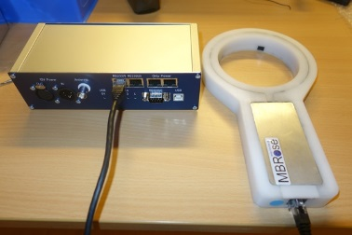
Antenna and RFID reader with USB
WS-2
Connection box – 4 serial to USB
2 RFID Reader
2 Balances
Antenna with embedded RFID reader and RS-232 Interface.
Diameter 100 mm

Slide 6
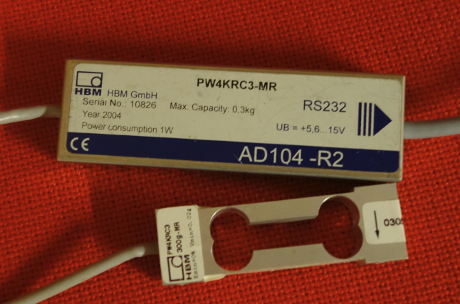
Load Cell Chain
RS-232
Load Cell (300 g)

Slide 7
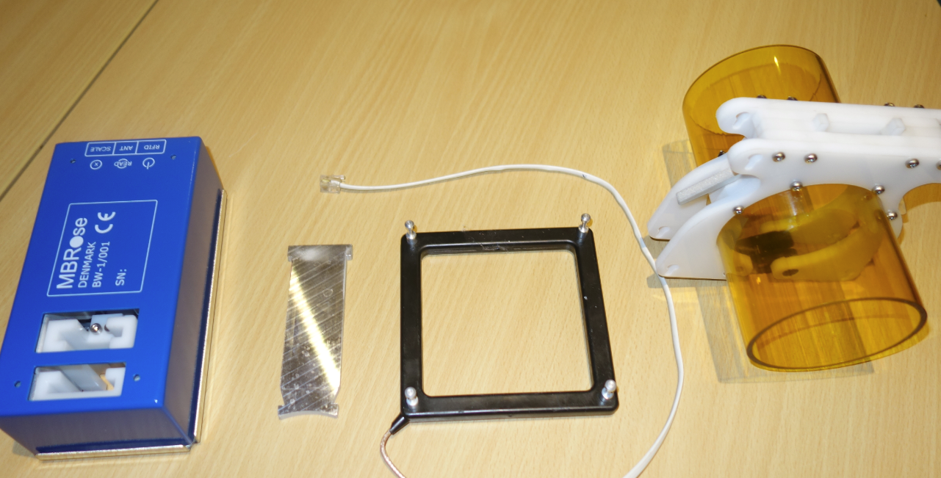

BW-1 Components
Video

Slide 8
Block Diagram
RS-232 Balance output
USB
Load Cell
Amplifier
AD-Converter
RS-232 to USB
RS-232
RFID Output
Antenna
RFID-Reader
Computer
Balance output example: 99.99 g
More info: ba_ad105_e_2
RFID output example (RAW): Z5A2080A70C2C0001
More info: RFID Reader.docx

